Slide 1

Burn wound healing model
Mark de Boer
Ben Dickens

Slide 2

Index
Previously built models
Research proposal
Possible biomarkers
Possible sociomarkers
Data available?

Slide 3
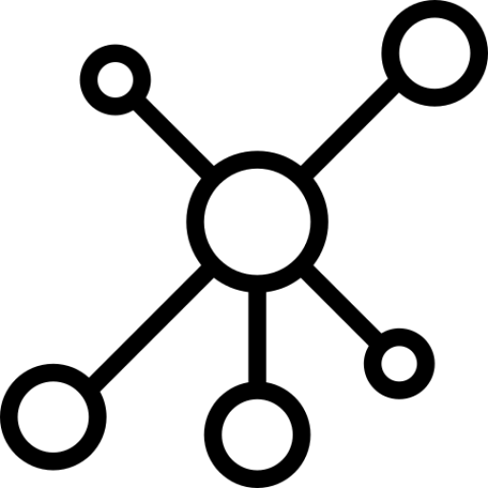

Previously built models
Dynamic ABM computational frameworks simulating
cutaneous wound healing.
Dynamic computational Alkaline Phosphatase (AP) models
to study the immune response process in wound healing.
Notes:
Perfect skin regeneration of burn wounds remains a challenge. There is still a lack of fundamental understanding of the interactions between different cell types, complex cell signalling networks and mechanical feedback loops during the wound healing process. Previous efforts have focused on constructing dynamic computational frameworks simulating cutaneous wound healing [1,2,3], but have not focused on burn wound healing.
In addition, dynamic computational models have been used to study the inflammation process in wound healing. Presbitero et al. [4] constructed a validated numerical systemic inflammation model under clinical treatment conditions of the Alkaline Phosphatase enzyme. Alkaline phosphatase (AP) exhibits anti-inflammatory effects by dephosphorylating inflammation triggering moieties (ITMs) like bacterial lipopolysaccharides and extracellular nucleotides.
These models are all not burn wound specific, therefore adjustments or an expansion of these models are demanded, to simulate the burn wound procedure. The link between the AP model and the cutaneous wound healing models, has not been investigated/found yet. By first performing a literature review focused on possible connections, this will be investigated. Constructing a computational model simulating burn wound healing would be a step forward towards a better understanding of dynamical adaptation to heal burn wounds.
ABM: simulating the actions and interactions of autonomous agents (both individual or collective entities such as organizations or groups) with a view to assessing their effects on the system as a whole

Slide 4
On the mathematical modeling of wound healing angiogenesis ~ Flegg
Computational modeling of chemo-bio-mechanical
Coupling toward
wound healing ~ Tepole
A multi-agent cell-based model for wound contraction ~ Boon
2014
2015
2016
2007
2013
2017
2018
Agent-based model of inflammation and wound healing ~ Mi
Computational Modeling of Inflammation and Wound Healing ~ Ziraldo
Computational systems mechanobiology of Wound Healing ~ Tepole
Alkaline Phospatase and it’s role in the Immune System ~ Sloot

Slide 5


Research Questions + Aim:
What causes a better healing of burn wounds?
What is the link between the AP model and the cutaneous wound healing model?
A novel computational framework combining the AP and ABM models
to simulate the healing of burn wounds

Slide 6

Proposal
Discrete Spatio-temporal Agent Based Model combining both the immune response model and the ABM wound healing models
The AP model will act like an engine for the blood composition of the abm wound model, which could be extended to 3d or approximate this

Slide 7
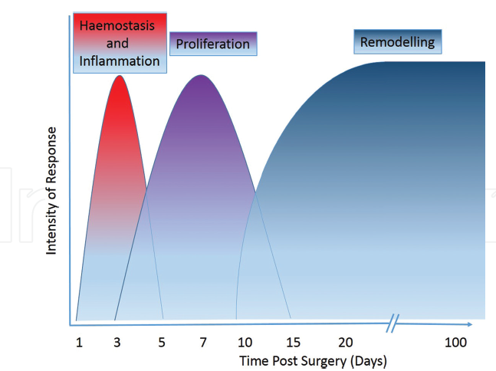
Introduction
4 Stages
Main difference from cuteanous wounds is the the loss of these skin appendages and re-epithelialisation, which can only occur from the edges of the wound.
Inflammatory response is fundamental to the healing process

Slide 8
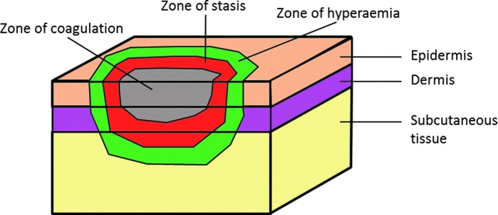
Spatio-temporal

Slide 9
Geometrical parameters:
Length, width, Depth of burn (2nd – 0.12 to 2.0 mm), surface, volume
Total Body surface area of burn (TBSA) (Wallace Rule of Nines)
Burn Location/s

Slide 10
Relevant Socio-markers
Age
Gender

Slide 11
DATA?

